Slide 1

Paris 2024 Olympics Data Project
This presentation explores the insights derived from a comprehensive data analysis project focused on the upcoming Paris 2024 Olympics. The project leverages a variety of datasets, including athlete information, medal records, and historical performance trends, to uncover valuable insights and forecast future outcomes.
Done by:
Sadhvika Chaparla
Hithesh M R
Swethashree K A
Chandra Prakash Reddy
Akash Gundu
Notes:
1

Slide 2
Data Sources and Preprocessing
Data Sources
Preprocessing
The data source, including official Olympic athletes, coaches, events, medalists, medals, schedules, teams, venues of all the events held.
The raw data is preprocessed to ensure consistency, accuracy, and completeness. This includes data cleaning, normalization, and feature engineering.
Notes:
2

Slide 3
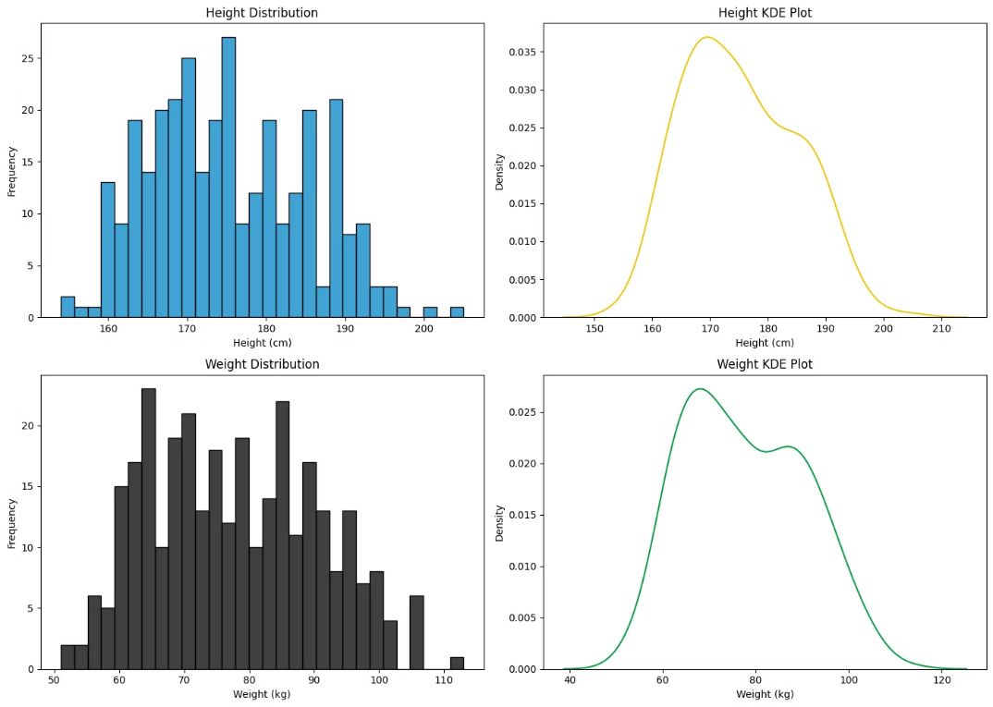
Athlete Analysis and Insights
EDA on athletes.csv
Notes:
3

Slide 4
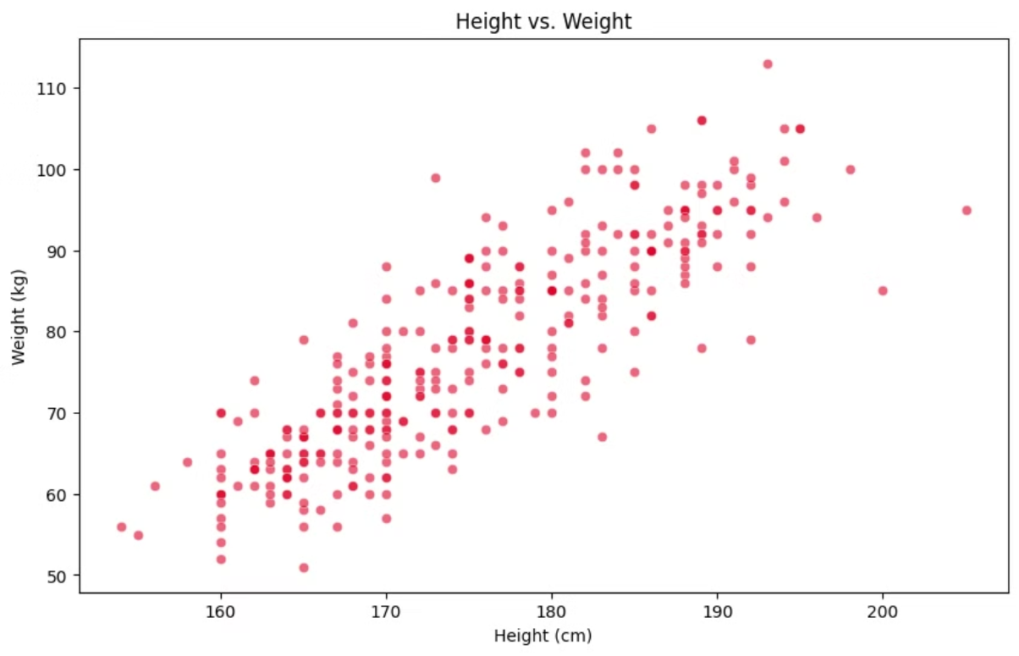
Insight:
The Athletes height who participated in the Paris Olympics 2024 ranges from 150 - 200 cms, the mean height 175.25 cms.
The weight ranges from 50 - 120 kgs, the mean weight 77.75 kgs.
Notes:
4

Slide 5
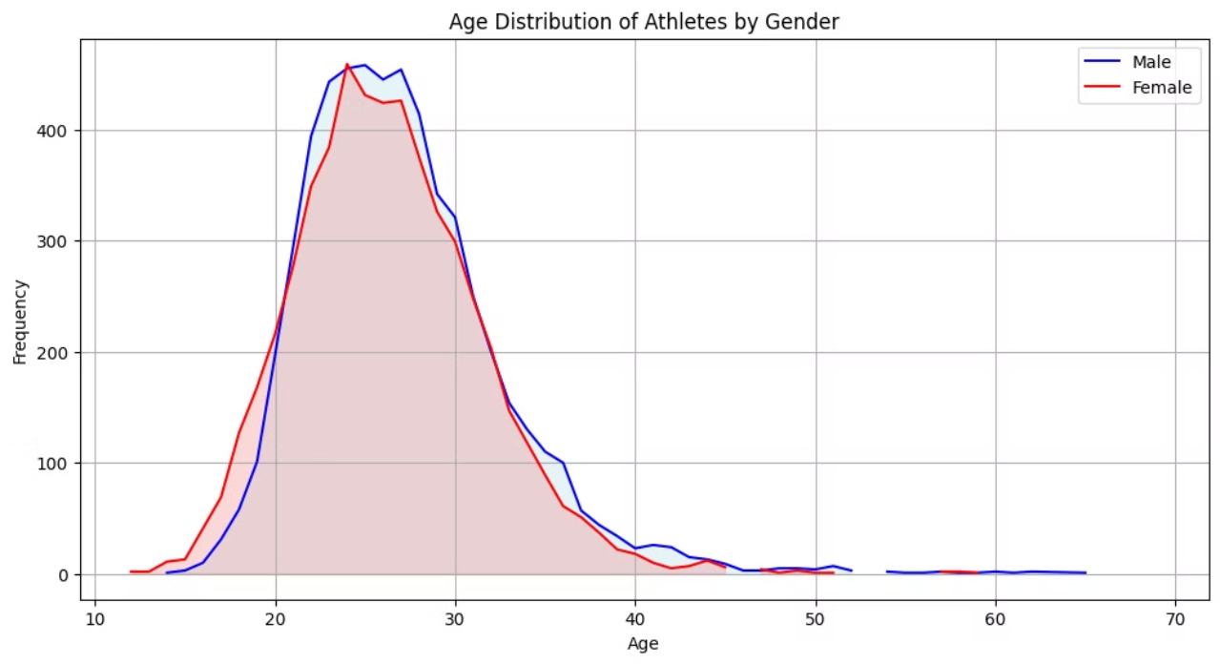
Insight:
Female 26.341951 Male 27.085249
The graph is the age distribution of male and female athletes is different. Male athletes have a peak around mid-20s, while female athletes have a peak in their early 20s. This could be because of the physical demands of different sports or societal expectations and opportunities for male and female athletes.
Notes:
5

Slide 6
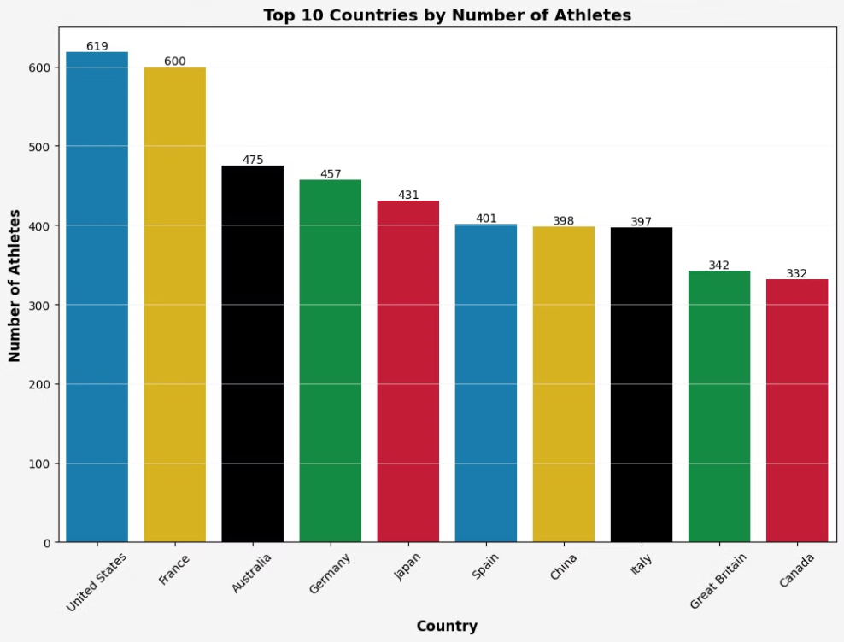
Insights:
The graph shows the number of athletes who participated in each country [USA, France, Australia, Germany, Japan], and these countries have given more participants to the Olympics.
Notes:
6

Slide 7
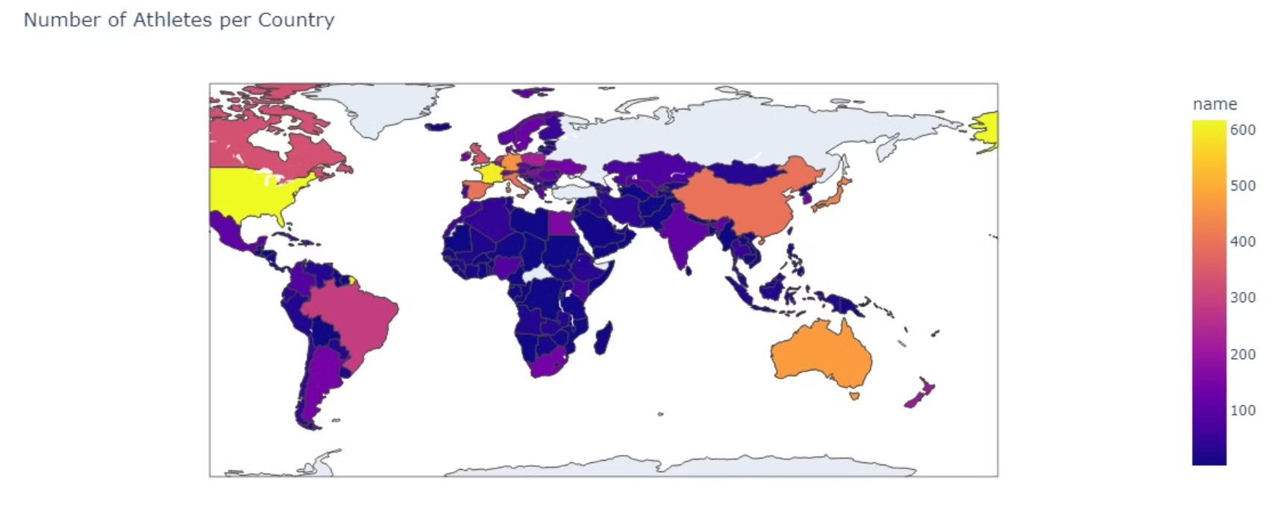
The choropleth map gives a detailed visualization of participation of the enter globe.
15 Russian athletes competed in the 2024 Paris Olympics as "Individual Neutral Athletes" (AINs). The International Olympic Committee (IOC) allowed some Russian athletes to compete under neutral conditions, but not all, due to Russia's invasion of Ukraine in February 2022.
USA, France, Australia, Germany, and Japan have higher Olympic participation due to large populations, strong sports cultures, economic resources, government support, historical success, and well-organized sports governing bodies.
Notes:
7

Slide 8
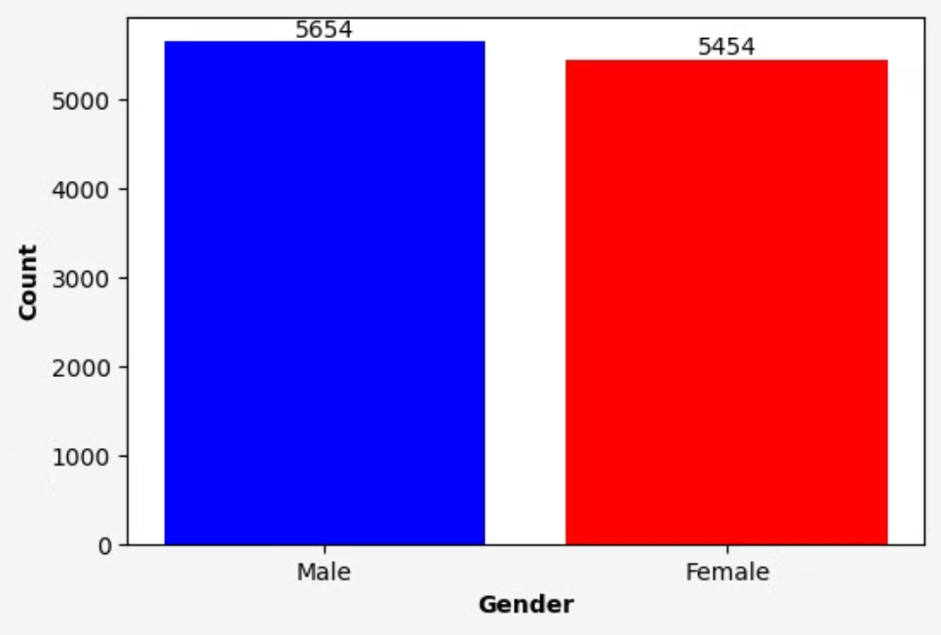
Insight: This year the Olympics had 1.04:1 Male to Female ratio.
Notes:
8

Slide 9
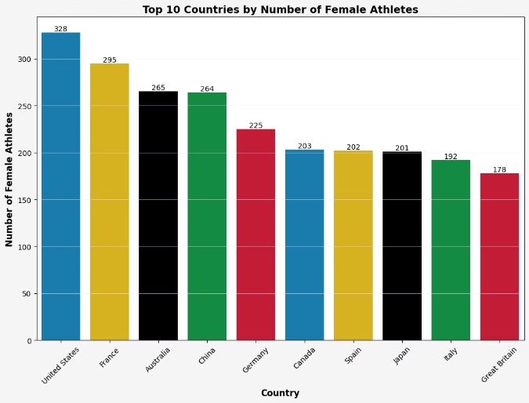
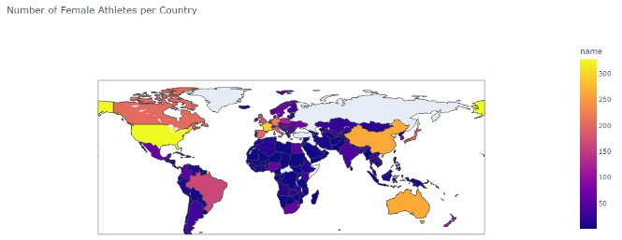
Insights:
The graph shows the top 10 countries by the number of female athletes participating in the 2024 Olympics.
The graph shows the top 10 countries with the most female athletes in the 2024 Olympics. The United States leads with 328 participants, followed by France and Australia. This indicates a growing trend of female participation in the Olympics.
Notes:
9

Slide 10
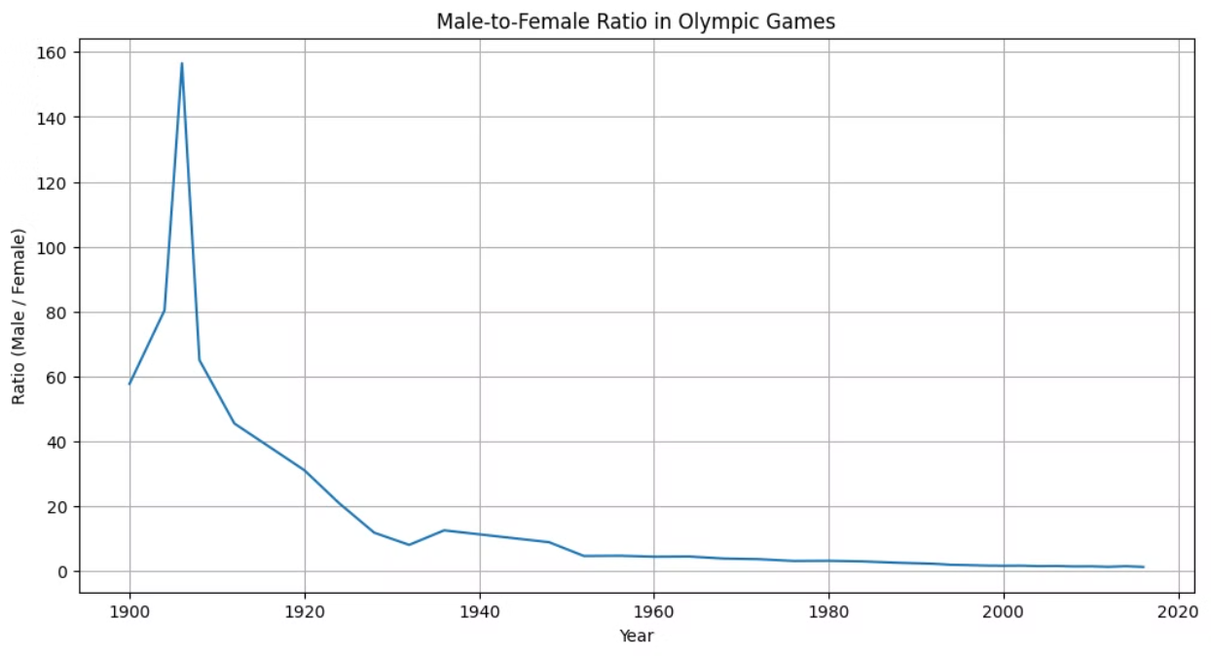
Insights:
The graph shows the male-to-female ratio in the Olympic Games from 1900 to 2020. The ratio starts high in 1900 and decreases significantly over time, indicating a growing participation of female athletes in the Olympics. While there is a slight increase in the ratio around the 1940s, the overall trend is a steady decline towards gender equality in the Games.
Notes:
10

Slide 11
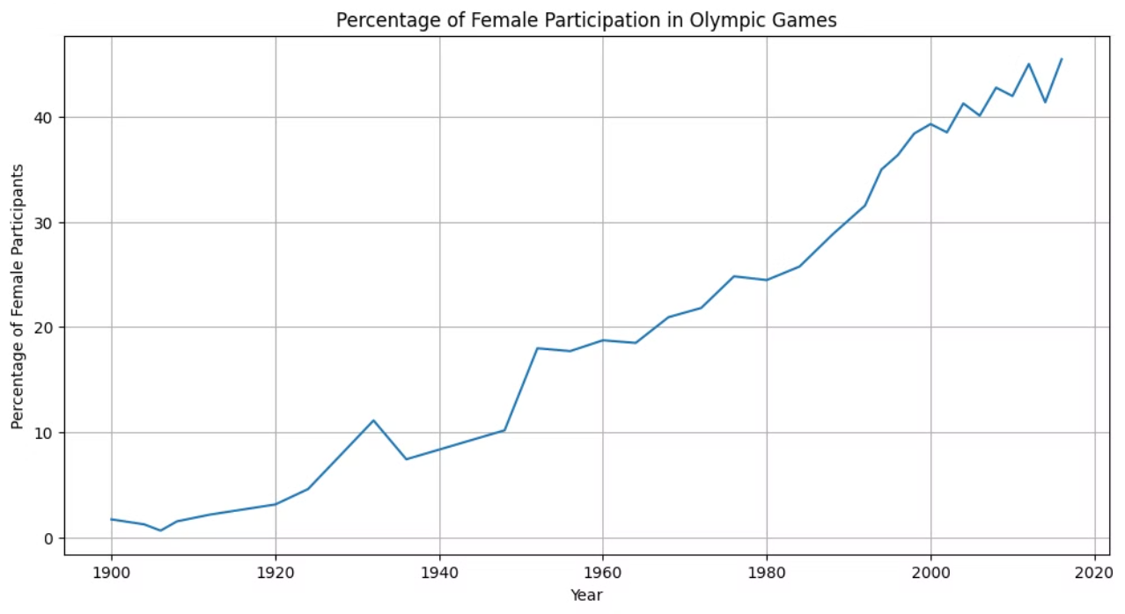
Insight:
The graph shows the percentage of female participation in the Olympic Games from 1900 to 2020. There is a clear upward trend, indicating a significant increase in the number of female athletes participating over time. While the growth was initially slow, it has accelerated in recent decades, demonstrating a positive shift towards gender equality in the Games.
Notes:
11

Slide 12
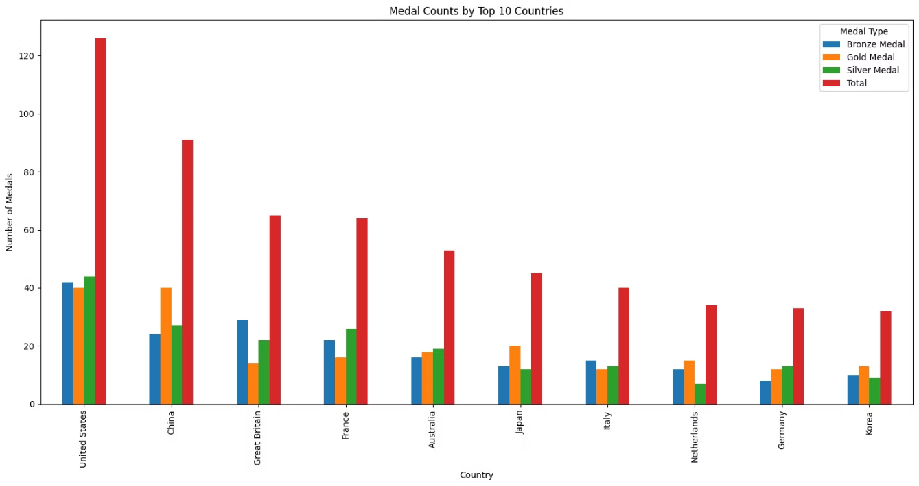
Insight:
The United States leads with the highest total number of medals, followed by China and Great Britain. However, China boasts the most gold medals, while the United States has the most silver and bronze medals. The remaining countries in the top 10 include Australia, France, Japan, Italy, the Netherlands, Germany, and Korea.
Notes:
12

Slide 13
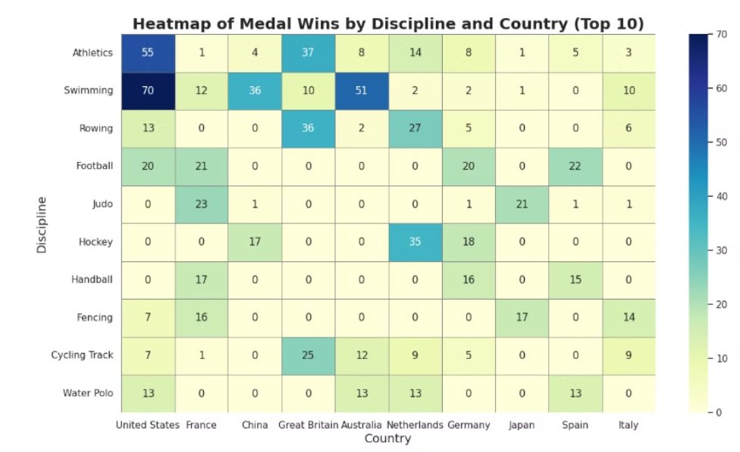
Insights:
United States Dominance: The United States leads in overall medal count, excelling in a wide range of sports.
Swimming Success: Both the United States and Australia demonstrate significant strength in swimming, with numerous gold medals.
European Strength: European countries like France, Great Britain, Germany, and Italy have a strong presence in multiple sports, showcasing their athletic prowess.
Specialized Strengths: Certain countries have niche strengths in specific disciplines. For example, China excels in table tennis and badminton, while Japan dominates in judo.
Notes:
13

Slide 14
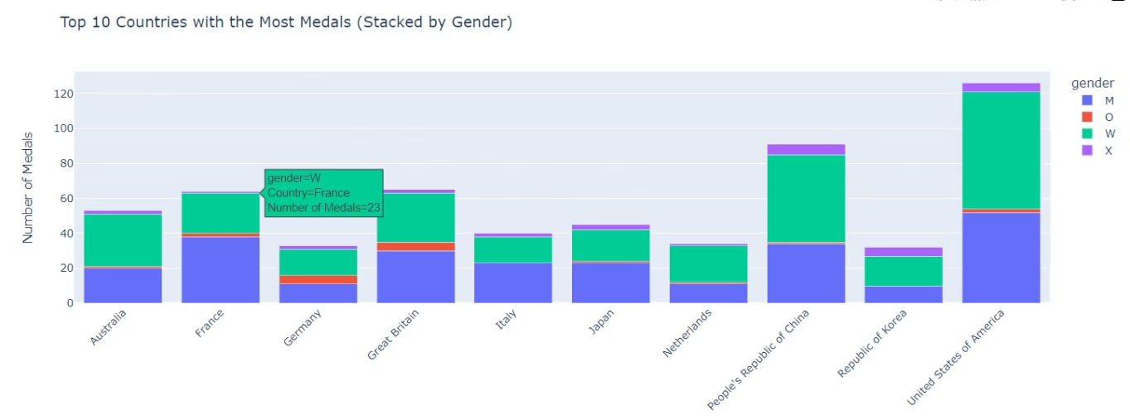
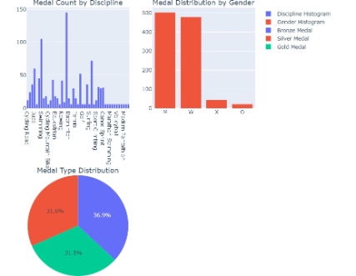
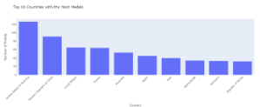
Medal Analysis and Insights
1
2
Historical Trends
Examining historical medal data reveals patterns in medal distribution, identifying dominant countries, emerging sports, and potential shifts in performance trends.
Medal Distribution
The analysis reveals the distribution of medals across different sports, countries, and athlete categories, identifying trends and potential surprises in the upcoming Games.
Notes:
14

Slide 15



Future Prospects
Future Prospects
Scenario Planning
The forecasting models can predict medal outcomes for the next Olympics, providing insights into potential medal contenders, expected performance levels, and potential surprises.
Scenario planning allows for the exploration of different outcomes based on various factors, including athlete performance, unexpected events, and changes in the global sports landscape.
Notes:
15

Slide 16

Challenges and Limitations
Data Availability
Limited access to comprehensive and accurate data can impact the accuracy of analysis and forecasting.
Data Quality
Inconsistent data quality can introduce bias and inaccuracies, requiring careful validation and preprocessing.
Prediction Uncertainty
Forecasting models are inherently uncertain due to the unpredictable nature of sporting events and the influence of external factors.
Notes:
16

Slide 17





Conclusion and Next Steps
Key Insights
The project has provided valuable insights into athlete performance, medal distribution for the Paris 2024 Olympics.
Further Research
Continued research can focus on refining forecasting models, incorporating emerging data sources, and exploring each country's participation and athlete's performances.
Data Visualization
Interactive data visualizations can be developed to effectively communicate insights and facilitate decision-making for stakeholders.
Notes:
17

